Slide 1

UNH SEDS
CEPS Engineering Organization
High Power Rocketry

Slide 2
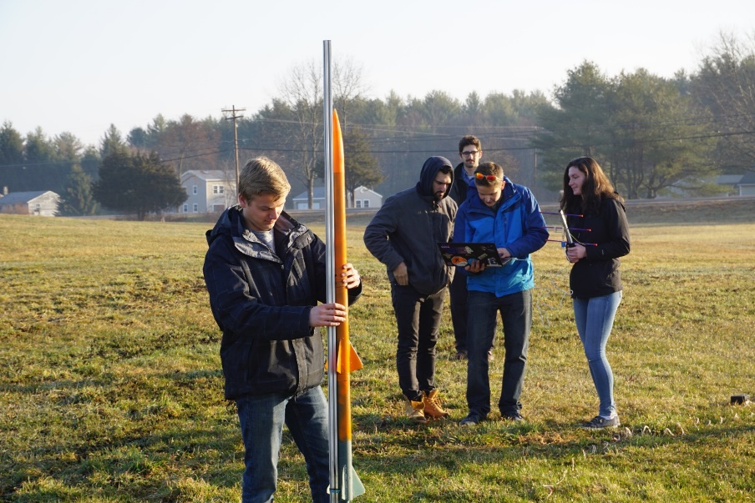
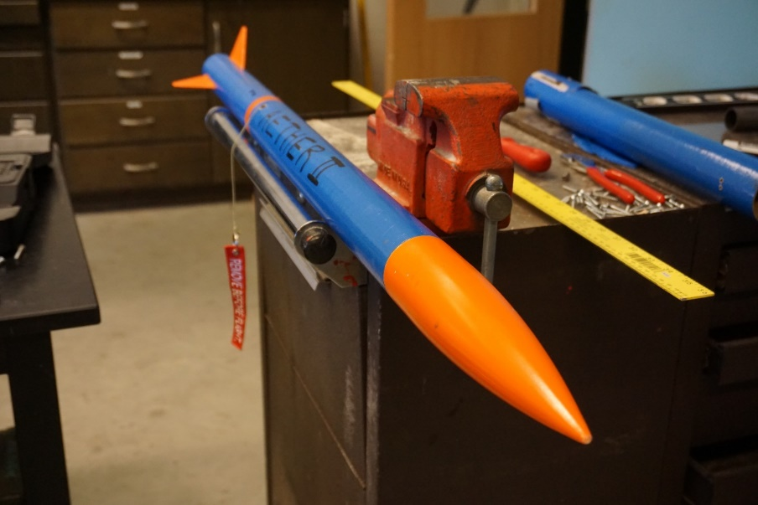
What is UNH SEDS?
Students for the Exploration and Development of Space (SEDS) is a non-profit that empowers young people to participate and make an impact in space exploration. SEDS helps students develop their technical and leadership skills by providing opportunities to manage and participate in national projects as well as to attend conferences.
We are an interdisciplinary rocketry organization founded in 2017 that has 30 members from 6 different majors and every class.
Notes:
Seds is a naitionwide organization that allows colleges from around the world to start a chapter. Although we are allowed to do whatever we would like as an organization, they do sponsor competition for SEDS groups as well as national conferences, the next one for the beginning of November. We are a team comprised of many majors and all classes, so applying to join our team would not only be a senior project, but an interdisciplinary experience.

Slide 3
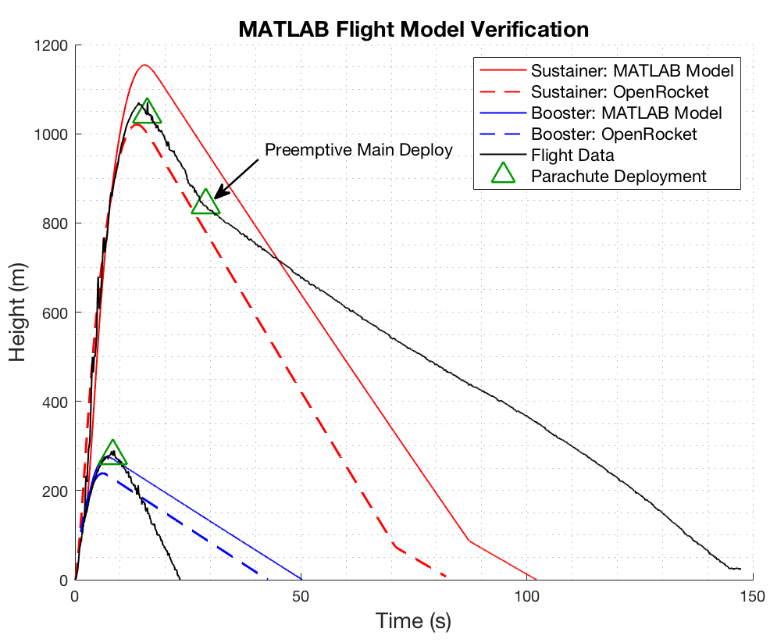
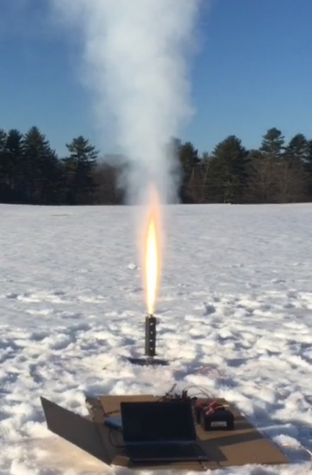
What Have We Done?
Worked on increasing our ‘Body of Knowledge’ in rocketry building techniques by building and launching eight rockets in a local field in Lee, NH.
Created and optimized launch simulations to accurately predict the flight path of each rocket flown
Used MATLAB to optimize rocket dimensions to maximize flight apogee
Measured thrust of our engines using a static test fire rig to more accurately predict the flight path of our rocket

Slide 4
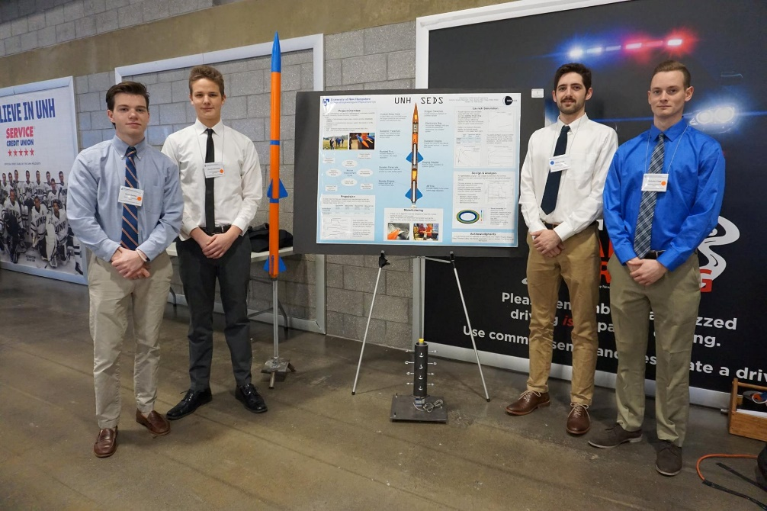
What Have We Done?
Placed second place at the URC in the mechanical engineering competition teams in Spring 2018
Competed in the University Student Rocketry Competition in September 2018 hosted by SEDS USA with a near-nominal flight

Slide 5
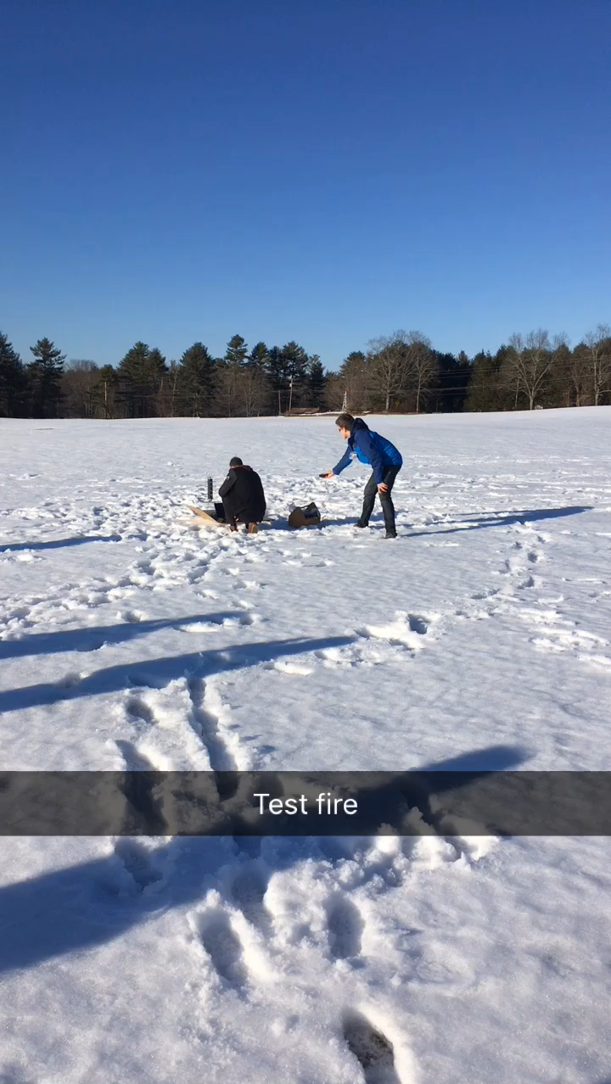
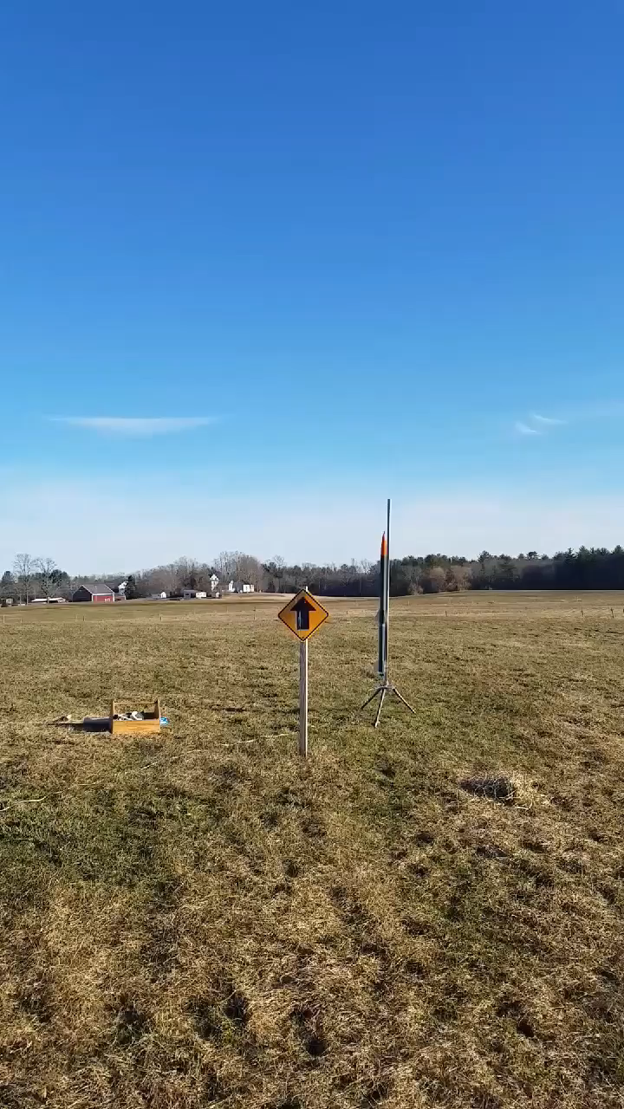
Examples…
Our static test fire for our competition booster engine
Our first successful multistage rocket

Slide 7
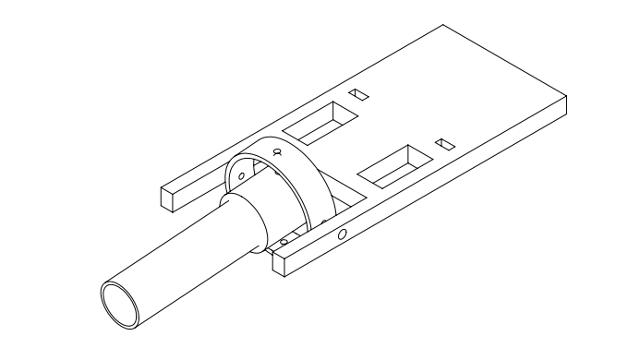
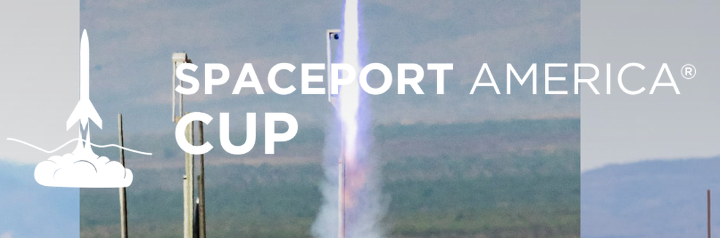
Goals for UNH SEDS 2018-2019
Finish participation in the University Student Rocketry Competition
An incorporated hybrid rocket engine with gimbal assembly
Compete in SpacePort America Cup
Gimbaled Hybrid Engine, carbon fiber body
Flight computer on board to control thrust, staging events and recovery.
Notes:
Note these are our technical goals, we have many plans to begin outreach events to inspire others to enter STEM and get inspired with space exploration

Slide 8
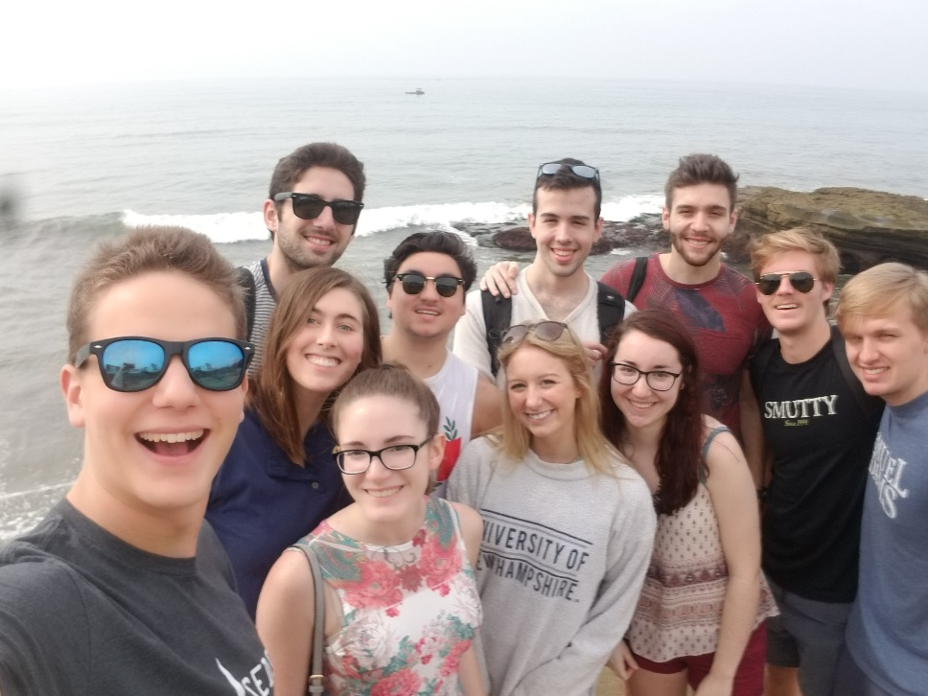
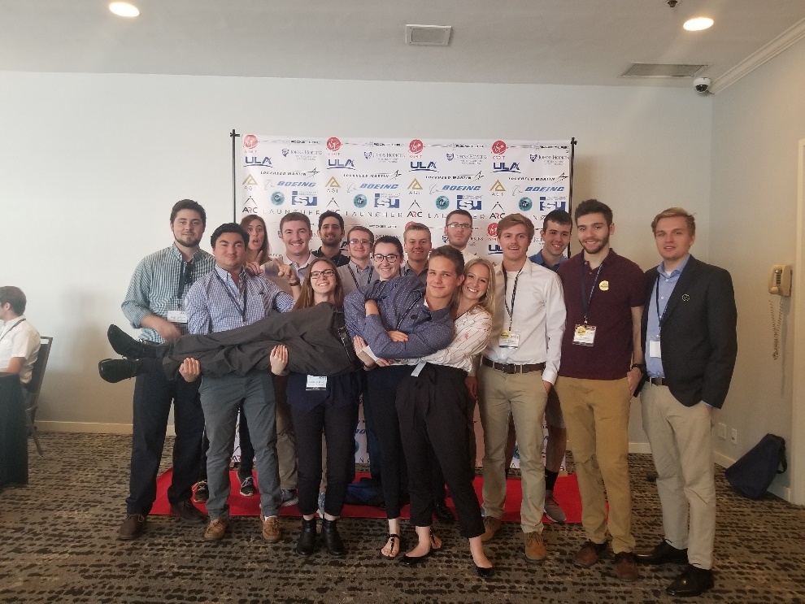
What else?
SEDS USA hosts a national conference every year called ‘SpaceVision’ where many of the various SEDS chapters congregate to network and listen to speakers. This year, it was on November 2018 in San Diego, California. We brought 16 of our members to take part in the event.
Notes:
EE major too

Slide 9
Questions?

